Slide 1
Structuring the Application

Slide 2
Module Overview
The public folder
The src folder Build output Entry point Modules Components

Slide 3
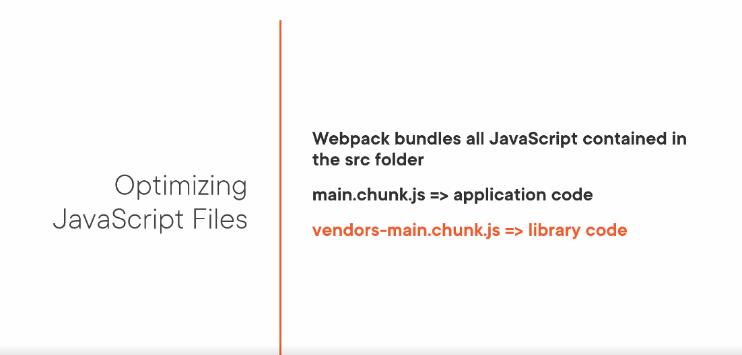

Slide 4
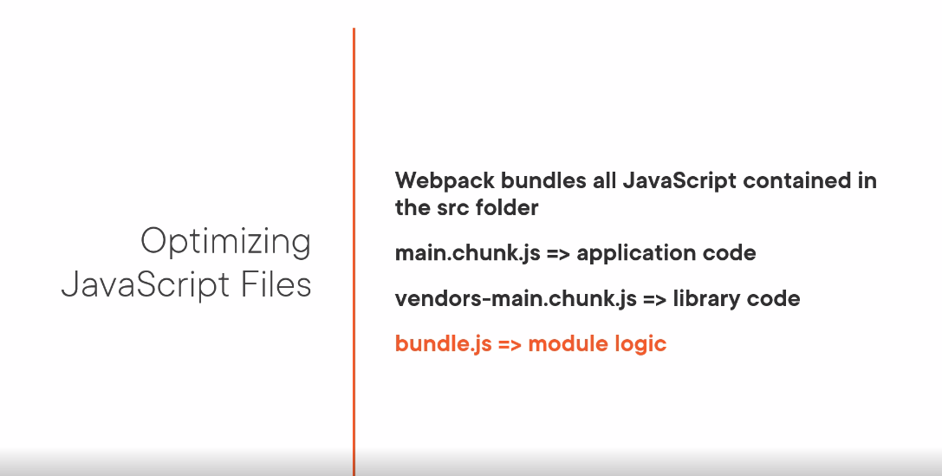

Slide 5
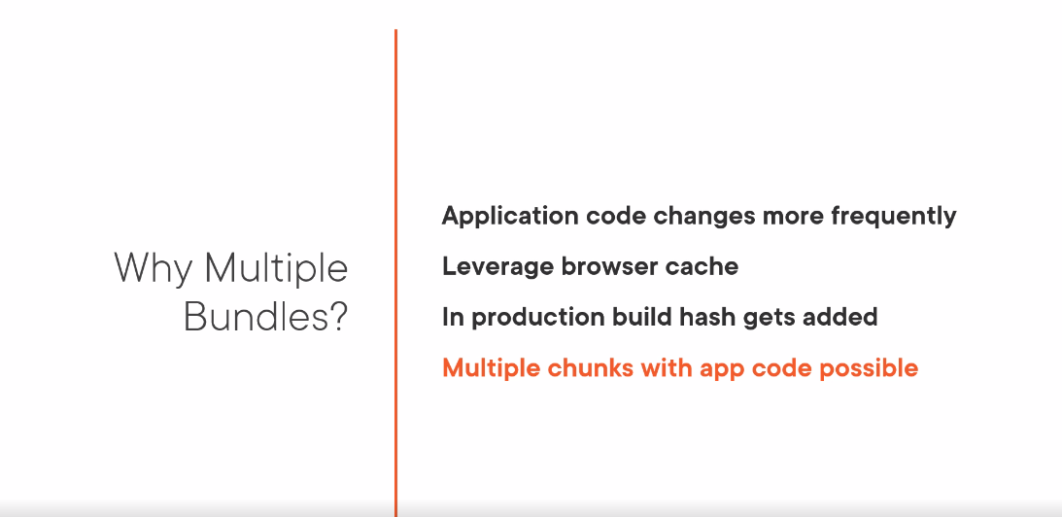

Slide 6
Modules
module.js
anotherModule.js
Import {component} from "./module";
component.doSomething();
class component { doSomething() {
}
}
export component;

Slide 7
Modules
module.js
anotherModule.js
import comp from "./module"; comp.doSomething();
class component { doSomething() {
}
}
export default component;

Slide 8
Modules
module.js
anotherModule.js
class component { doSomething() {
}
}
const x = 10;
export default component, x;
import comp, {x} from "./module";
comp.doSomething(); console.log(x);

Slide 9

Initial app structure
public folder
Summary
src folder
Entry point Modules
Top-level component
Importing external modules Placing components in folders

